Slide 1
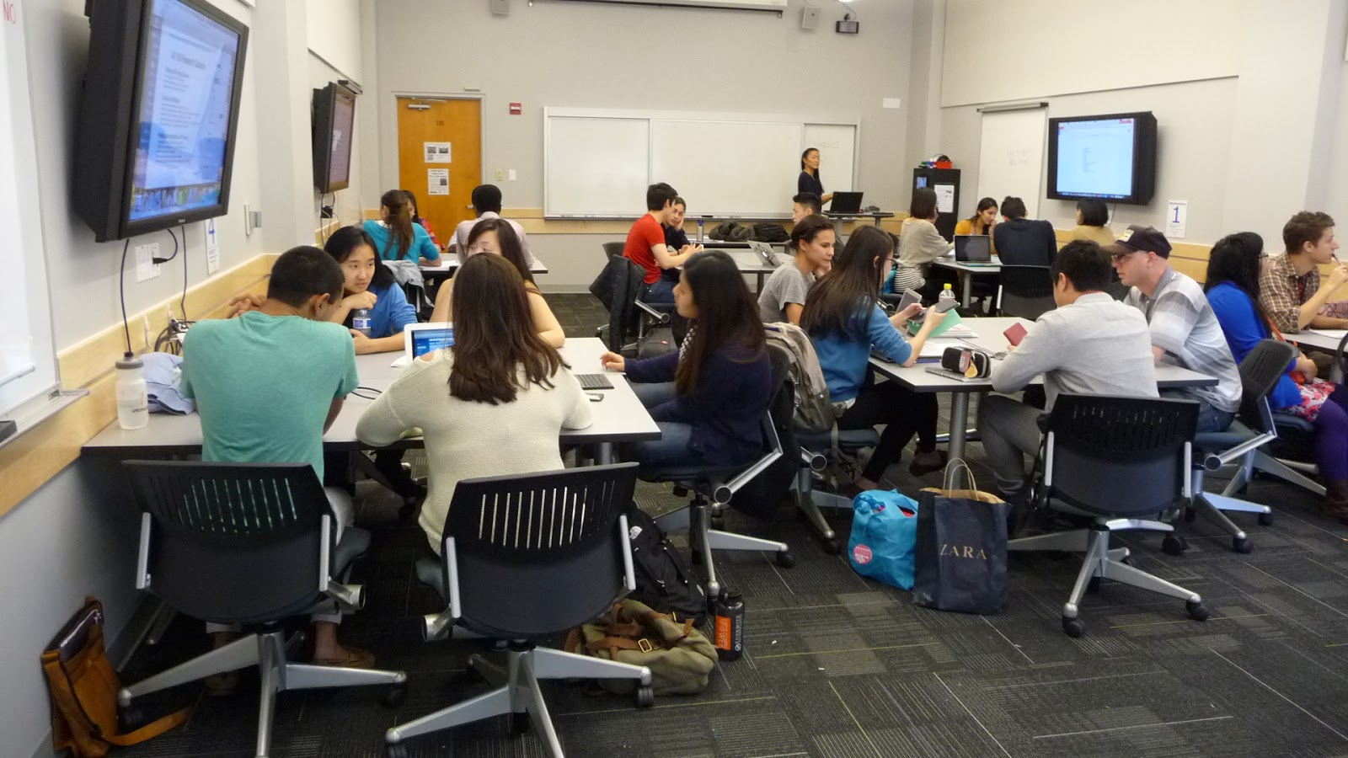
Basic Active Learning Concepts
GPS Workshops-Practical Pedagogy

Slide 2
How would you define active learning?
(take 1 minute to write down your thoughts)
Turn to the person next to you and discuss.

Slide 3
What is active learning?
“instructional activities involving students in doing things and thinking about what they are doing.” (Bonwell & Elison, 1991)
Passive v. Active a False Dichotomy? (Zakrajsek, 2016)
Constructivism & Social Constructivism
Intentional engagement with course material aided by purposeful social interactions and self-reflection

Slide 4
What are the benefits of active learning?
Deepen student understanding of a given topic (challenging or abstract)
Provides insight into how well students are grasping concepts
Builds social connections that have positive performance benefits
Prompt students to take charge of their learning experience

Slide 5
Things to think about…
Create an open and safe environment (might be some resistance)
Set a goal for the activity
Learning objectives
3. Consider what is the right activity based on learning objective
4. Identify preparation for the exercise
Time considerations
5. Consider links to other class elements
6. Plan how you will introduce the activity
Outside student prep
7. Plan the logistics
8. Consider how you will judge success
Student reflection
Just go for it!
10. Get feedback, Iterate, and Expand

Slide 6
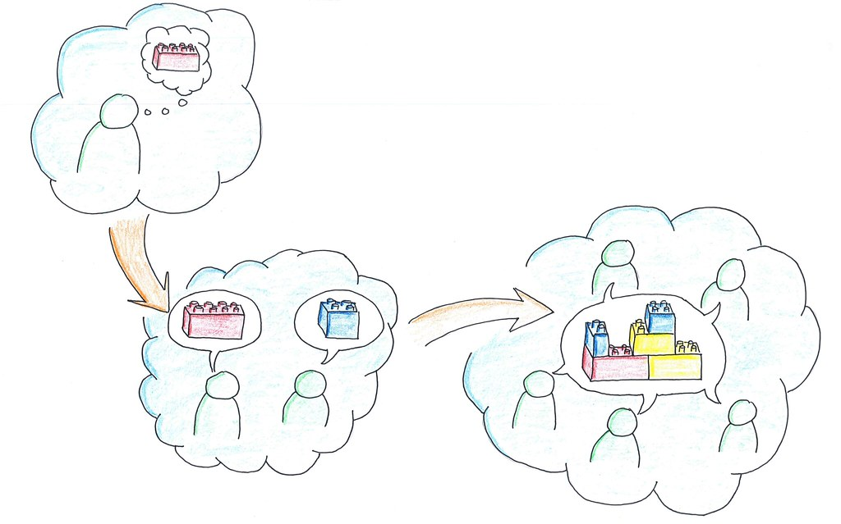
Strategies that Require Little Prep
Think, Pair, Share (Kothiyal, 2014)
Concept Mapping/ Graphic organizers
Basic Small Group Discussion
One Minute Papers
Crowdsourcing
KWL (Know, Want to know,
Learned)

Slide 7
Let’s Go For It!

Slide 8
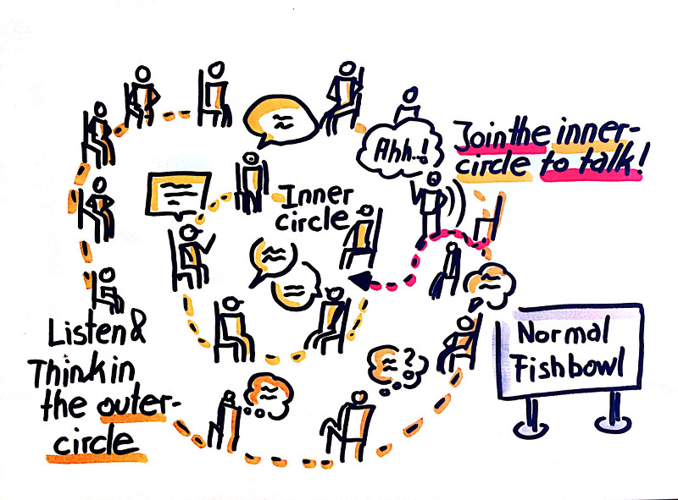
Fishbowl Discussions
Pineapple on Pizza: Yay or Nay?
Take one minute to write down your position. Provide evidence and reasoning.
Pro-Pineapple individuals enter the discussion circle. Anti-pineapple individuals will stand outside and take notes on the discussion.
Switch and take on opposite rolls.
Come together for a larger group discussion on what we learned.

Slide 9
Benefits of the Fishbowl
Can work in large classes
Customizable
Great for sensitive and controversial topics
Ensures multiple perspectives are heard
Allows students to work on social skills
Higher orders of thinking
Things to Consider:
Establish firm rules
Prepare students
Think about how participation will be measured

Slide 10
Divide and Conquer
Students will divide into groups and draw a concept from the hat
Students will work together to define and evaluate the concept and then devise a plan to teach it to the rest of the class (act it out, draw it, create a step-by-step guide) BE CREATIVE!
Come together as a group to teach the rest of the class about your idea

Slide 11
Benefits of Divide and Conquer
Tackle multiple ideas, texts, and problems simultaneously
Builds social skills
Fosters student confidence
Encourages higher orders of thinking Things to consider:
Prepare students
Give students adequate time
Act as a guide

Slide 12
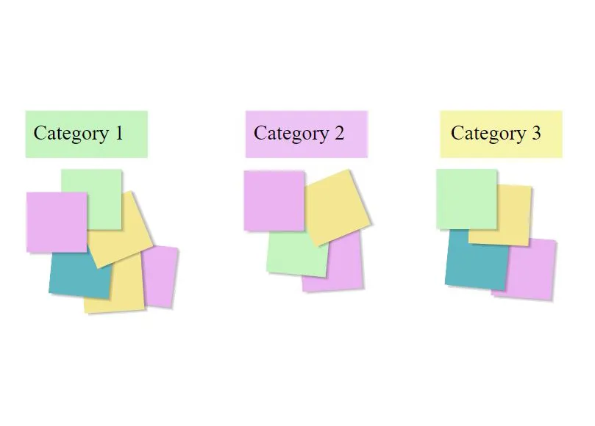
Affinity Grouping
Students will be divided into groups and given sticky notes with historical events.
You will work as groups to place these events in the correct decade on the board.
We will come together to discuss the accuracy of the groupings.

Slide 13
Builds social skills
Encourages higher orders of thinking
Movement (great for early morning or after lunch)
Things to consider:
Prepare students
Create an environment where it is okay to be wrong
Space is a consideration (turn to digital tools)
Benefits of Affinity Grouping

Slide 14
The possibilities are really endless…
Gamification
Field Trips (check out what the university offers)
Class Surveys and Polling
Stations
Case Studies
Note Sharing
Various types of Reflection and Metacognitive activities
When implementing a strategy:
To do this format well, I as an instructor need to…
When done well, students will the following skills/perspectives…

Slide 15
Ending with some Reflection
What were my biggest takeaways from today’s workshop?
What techniques and strategies do I want to try in my classroom?
What is the first step I can take to implement one of the strategies?

Slide 16
Resources and articles
Strategy Guides:
Northwestern's Guide to Active
Learning Activities
Active Learning Example Videos for the Sciences
Articles and Research:
Freeman, S., Eddy, S. L., McDonough, M., Smith, M. K., Okoroafor, N., Jordt, H., & Wenderoth, M. P. (2014). Active learning increases student performance in science, engineering, and mathematics. Proceedings of the National Academy of Sciences, 111(23), 8410-8415.
Bonwell, C.C. & Eisen, J.A. (1991). Active Learning: Creating Excitement in the Classroom. School of Education and Human Development, George Washington University: Washington DC.
Kothiyal, A., Murthy, S., & Iyer, S. (2014). Think-pair-share in a large CS1 class. Proceedings of the 2014 Conference on Innovation & Technology in Computer Science Education - ITiCSE '14. doi:10.1145/2591708.2591739.
Zakrajsek, T. (2016). All learning is an active process: Rethinking active/passive learning debate.” The Scholarly Teacher (weblog). https://www.scholarlyteacher.com/blog/all-learning-is-an-active-process
Dealey, J. (2020). Active Learning in Criminal Justice: The Benefits of Student Investigation of Wrongful Convictions in a Higher Education Setting. Learning and Teaching, 13(2), 85-. https://doi.org/10.3167/latiss.2020.130206

