Slide 1
Canadian Post-Doctoral Fellowship Workshop
Melanie Sekeres, PhD
School of Psychology,
University of Ottawa
Email: msekeres@uottawa.ca
Twitter: @MelanieSekeres

Slide 2
Ph.D. Physiology (Neuroscience)
Post-Doctoral Fellowship
Assistant Professor,
Dept. of Psychology & Neuroscience
2016-2020
Associate Professor, School of Psychology
Canada Research Chair

Slide 3
Canadian Post-doctoral Fellowships
What is a post-doc? Differences between USA and Canada
How do I find a post-doc?
How can I get funding for a post-doc in Canada?

Slide 4
What is a post-doc?
Post-doctoral training
- No longer a student, but not yet an independent scientist
- Opportunity to build and develop:
- Research productivity (publications, conference talks)
- Evidence of competitive funding (federal and foundation grants or awards)
- Mentorship and supervision of trainees
- Evidence of leadership in your field (invited talks, participate in peer-review, coordinating conference symposia)
- Teaching dossier

Slide 5
Do I really need to do a post-doc?
- Depends on your field/specialization
- Depends on what you want to do with your PhD
(i.e., teaching/lecturer; industry/industry research; academic research and research-intensive institute)
Your cumulative experiences are going to make you a competitive candidate
- publications, competitive funding, evidence of leadership and mentorship, training environment

Slide 6
Do I really need to do a post-doc?
https://www.nationalpostdoc.org/
https://www.postdocacademy.org/
https://www.christophertsmith.com/reflections/nih-best-blog-rewind-is-a-postdoc-worth-it

Slide 7
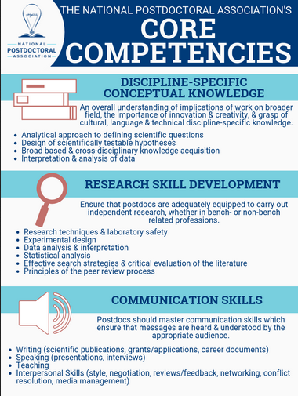
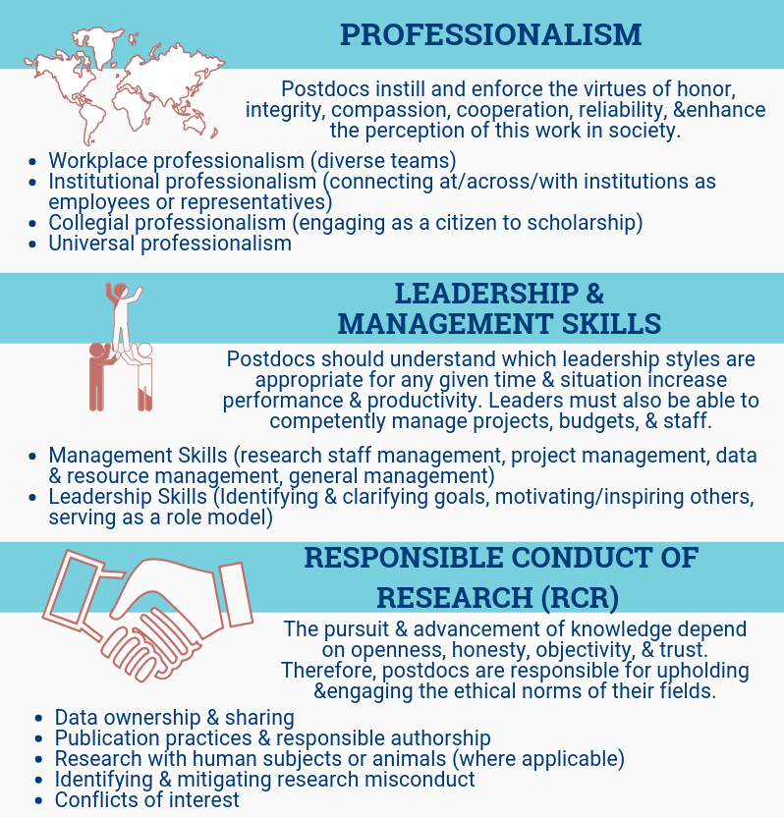
Do I really need to do a post-doc?
https://www.nationalpostdoc.org/page/CoreCompetencies

Slide 8
While you’re a graduate student
- Talk to your advisor
- Build your network
- Attend conferences and talk to people
Especially if there’s someone’s lab you’re interested in
- Get teaching experience

Slide 9
While you’re a graduate student
- Apply for funding
As a grad student, apply for small fellowships/ scholarships/travel awards
Apply for post-doc fellowship awards
NIH T32, F31, foundation funding
- Publish, present
- Look world-wide
Think about whether or not you really want to stay in the academic rat race (publications, grants, reviewing)

Slide 10
Canadian Post-doctoral Fellowships
What is a post-doc? Differences between USA and Canada

Slide 11
Canadian Post-doctoral Fellowships
What is a post-doc? Differences between USA and Canada
- Funding sources
- NIH, NSF (USA)
- CIHR (health), NSERC (basic sciences), SSHRC (social sciences) (Canada)
- Otherwise, the post-doc culture is very similar

Slide 12
Canadian Post-doctoral Fellowships
What is a post-doc? Differences between USA and Canada
How do I find a post-doc?

Slide 13
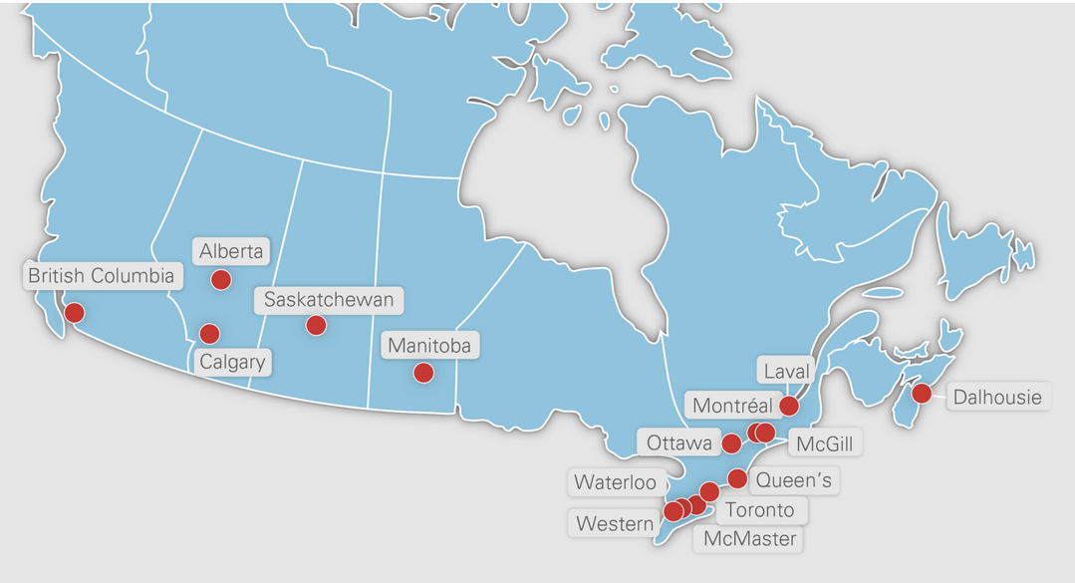
Finding a good postdoc
U15 (https://u15.ca/)
- Top 15 Research-intensive universities in Canada

Slide 14
Finding a good postdoc
- Most post-doc opportunities are not formally advertised.
- https://uwaterloo.ca/graduate-studies-postdoctoral-affairs/welcome-postdoctoral-affairs/become-postdoc

Slide 15
Finding a good postdoc
- Most post-doc opportunities are not formally advertised.
- Networking and making connections is the most important factor to finding a good post-doc.
- Who do you want to work with?
- Do they have grant funding to support a postdoc ?
- Is the training environment going to be supportive of productive and innovative research?

Slide 16
If your goal is to get an academic research position:
Q: What are key aspects of your post-doc work that set you up for success in obtaining academic jobs?
Find a post doc that:
- Allows you to publish
- Is at a reputable research institution
- Has a PI who has a successful funding record
- Allows you to expand your skill set
Difference between small liberal arts institution vs. large research-intensive (R1) institution (USA); U15 in Canada

Slide 17
Finding a good postdoc
APS postdoc exchange
www.psychologicalscience.org/postdoc-exhange
AAAS Science Careers
http://jobs.sciencecareers.org
Society for Neuroscience Jobs
http://neurojobs.sfn.org/jobs
Researchgate
https://www.researchgate.net/jobs
APA Monitor
http://www.psyccareers.com/jobseeker/
Chronicle of Higher Education
https://chroniclevitae.com/job_search/new?cid=chenav
Faculty for Undergraduate Neuroscience
https://funfaculty.org/drupal/jobs
Psychology Job Wiki
http://psychjobsearch.wikidot.com
http://psychwikipart2.wikidot.com/start#toc2

Slide 18
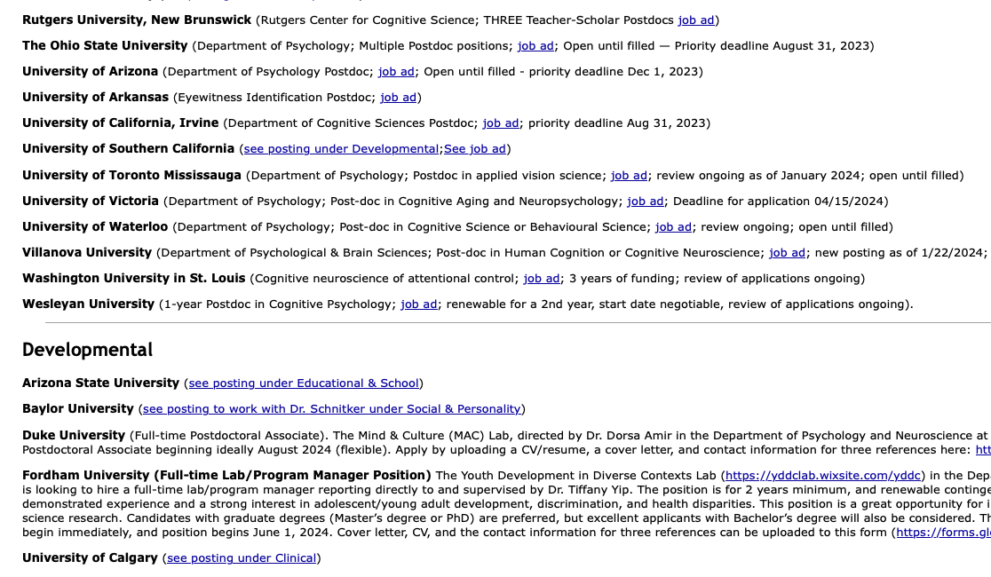
Finding a good postdoc

Slide 19
Being an international postdoc
- Non-Canadian residents require a work permit
https://uwaterloo.ca/graduate-studies-postdoctoral-affairs/welcome-postdoctoral-affairs/international-postdoctoral-fellows
https://www.canada.ca/en/immigration-refugees-citizenship.html

Slide 20
Canadian Post-doctoral Fellowships
What is a post-doc? Differences between USA and Canada
How do I find a post-doc?
How can I get funding for a post-doc in Canada?

Slide 21
Applying for post-doc funding
Tri-council funding agencies (Federal funding)
Canadian Institutes for Health Research (CIHR)
Like NIH; health focused research (international applicants can apply)
National Sciences and Engineering Research Council (NSERC)
Like NSF; basic sciences focused research (international applicants can not apply)
Social Science and Humanities Research Council of Canada (SSHRC)
Humanities focused research (international applicants can not apply)

Slide 22
Applying for post-doc funding
Banting Post-Doctoral Fellowships $70,000/yr (2yr max)
Deadline: September 2024 (requires institutional endorsement for application; international applicants can apply)
CIHR $ 40,000 + $5,000 research allowance /yr (3yr max)
Deadline November 2024
NSERC $45,000/yr (2yr max)
Deadline October 2024
SSHRC$ 45,000/yr (3yr max)
Deadline November 2024
Can only apply once per year to either tri-council agency
Can not apply for Banting Post-Doctoral award if you would concurrently hold tri-council funding
Must have obtained your PhD by time of award start date

Slide 23
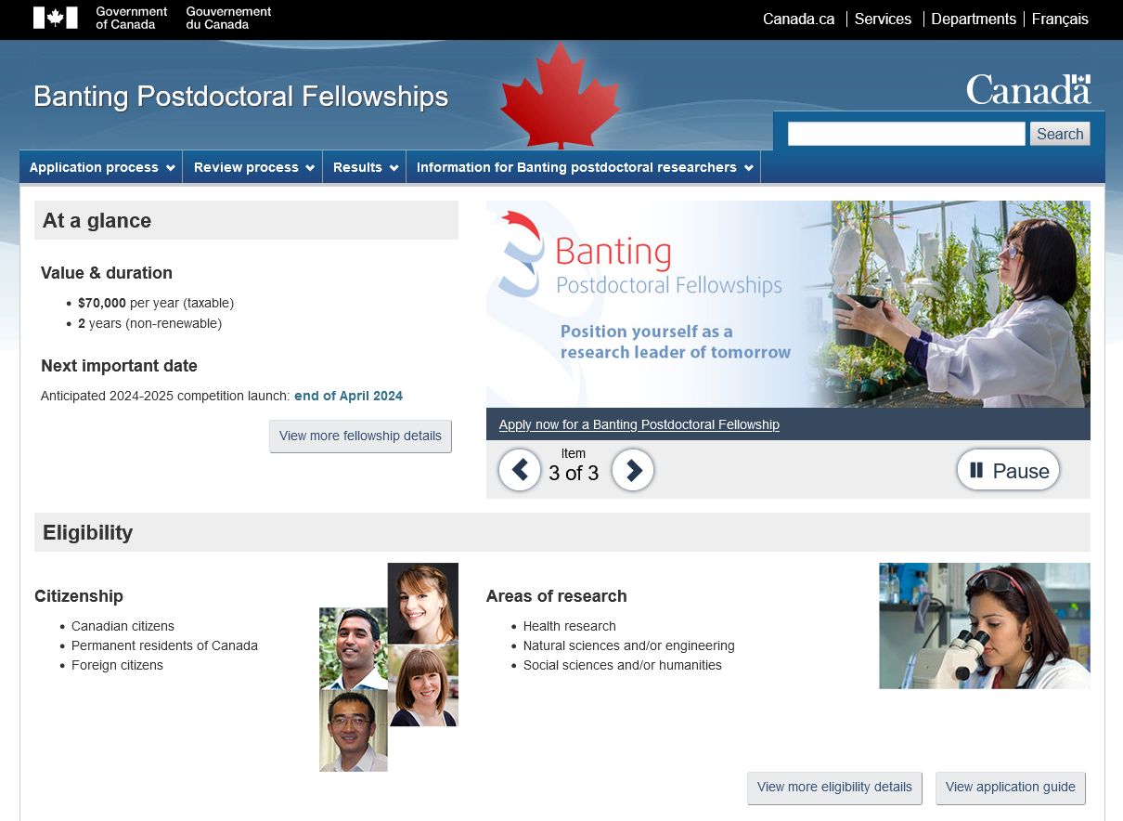
https://banting.fellowships-bourses.gc.ca/en/home-accueil.html

Slide 24
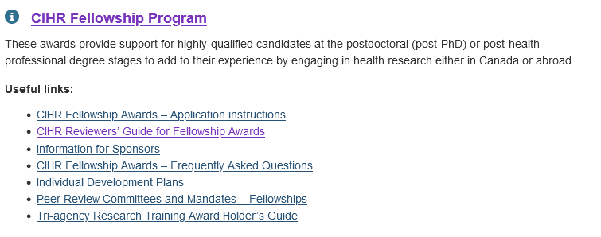
https://cihr-irsc.gc.ca/e/50513.html#details-panel2
https://www.researchnet-recherchenet.ca/rnr16/vwOpprtntyDtls.do?progCd=11277&language=E&org=CIHR

Slide 25
Applying for post-doc funding
Banting Postdoctoral Fellowships: Common CV + application
https://banting.fellowships-bourses.gc.ca/en/home-accueil.html
CIHR: Common CV + Researchnet
https://ccv-cvc.ca/
https://www.researchnet-recherchenet.ca/rnr16/LoginServlet?language=E
NSERC: Form 201
http://www.nserc-crsng.gc.ca/Students-Etudiants/PD-NP/PDF-BP_eng.asp
ASC: Common CV + My Review Room
https://ccv-cvc.ca/
https://asc.myreviewroom.com/

Slide 26
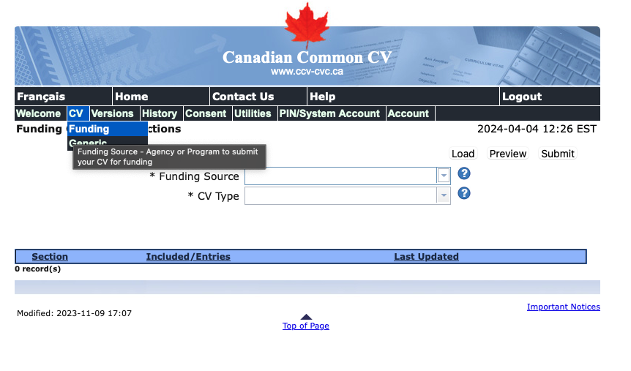
Common CV
https://ccv-cvc.ca/indexresearcher-eng.frm

Slide 27
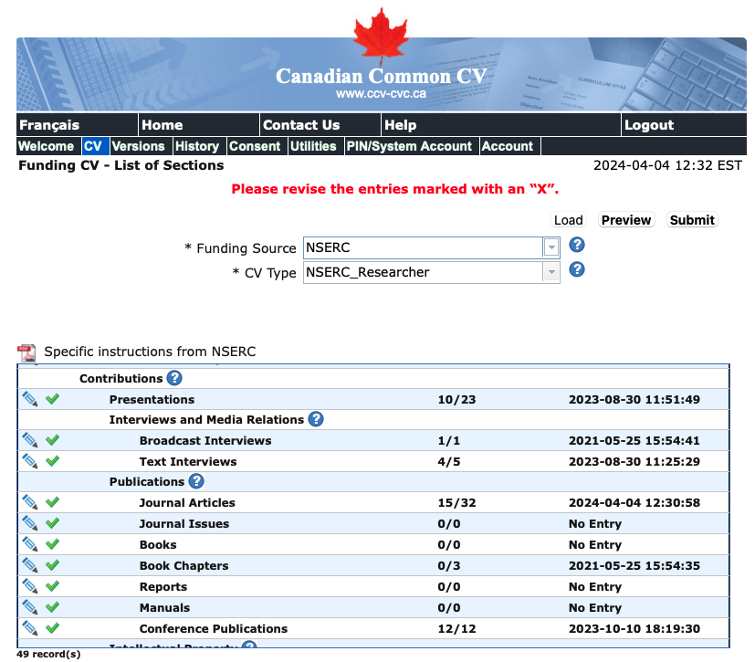
Common CV

Slide 28
Applying for post-doc funding
For an extended list of national and international post-doctoral funding opportunities:
https://research.fas.harvard.edu/postdoc_opportunities#external

Slide 29
Tips on preparing applications
Read the ‘Guide to Reviewers’ (know how you will be evaluated)
https://banting.fellowships-bourses.gc.ca/en/rev-eval_overview-apercu.html
http://www.cihr-irsc.gc.ca/e/26720.html
http://www.nserc-crsng.gc.ca/OnlineServices-ServicesEnLigne/instructions/201/a1_e.asp
http://www.alzheimer.ca/en/Research/How-to-apply/asrp-tips
Review the long-term strategic plans and initiatives of the agency, and incorporate their research priorities/terms in your training expectations plan.
Ensure your proposal in in line with the goals of the agency.
ie. use buzz words like collaborative, translational, interdisciplinary, accountability & transparency in research.. but don’t overuse them.
Title of Proposal matters
committee is assigned to a subset of applications based on overlap with expertise of those on panel
varied expertise on panel: biopsychology, cognitive, ERP & imaging, neuropsychology, animal research
Promote the contribution you hope to make to Canadian research
START EARLY!

Slide 30
Tips on preparing applications
https://alzheimer.ca/en/research/information-researchers/apply-alzheimer-society-research-program#Tips_for_Doctoral_and_Postdoctoral_Award_Applications

Slide 31
Tips on preparing applications
3 major adjudication criteria for the CIHR Fellowship program:
Achievements and Activities of the Candidate (Training Expectations; Proposed Research Project; Honours, Awards and Academic Distinction; Publications and Related Research Achievements) 60%
Sponsor’s Assessment of the Candidate’s Characteristics and Abilities 20%
Research Training Environment 20%
2 major adjudication criteria for the NSERC Fellowship program:
Research ability or potential 70%
Communication, interpersonal and leadership abilities (30%)

Slide 32
Training Expectations
Research Training Environment: Research Activity, Resources, Mentorship
10%
Proposed Research Project
20%
10%
10%
Honours, Awards, Academic Distinctions
Sponsors Assessments: Characteristics and Abilities of the Candidate
20%
30%
Publications and Research Achievements

Slide 33
Training Expectations (10%)
How does your previous research training relate to the present proposal?
Highlight all relevant academic experience here. If you have a body of work not directly related to the post-doc proposal, you can still mention it. “In addition to X, I have also been involved in research related to Y, which, while not directly related of the present proposal, has afforded a broad range of research experience…”.
Do not diminish your research experience.
Elaborate on your career goals
Clearly state your plan. Make it sound finite.
Emphasize your long-term plan to contribute to Canadian research.
How will this award enable you to establish yourself as an independent investigator?
Emphasize the independence you will have in planning, and conducting your studies.
Discuss the opportunity for local, national, and international collaborations, which will help you establish yourself in the research community.
Describe opportunities to disseminate your work at conferences and presentations.
Why you decided upon the training location and what do you expect to learn from the training experience?

Slide 34
Proposed Research Project (10%)
The ideal research project is the right balance of challenge, importance of the research question and feasibility in relation to the candidate's experience and training.
It is not the project per se that is being assessed, but how it will help you develop as a researcher.
Do:
Clearly state your hypotheses and state that you will test it by 1, 2, and 3.
Explicitly state why your project is novel “This is the first time…”
In the introduction, briefly state how your previous experience/findings relate to the current proposal (it’ll give your project cred)
End by stating how your proposal will contribute to “the good of humankind”, but be realistic.
Have someone outside of your lab review the proposal.
Don’t:
Don’t be too broad. You should be able to reasonably complete the experiments within a 2yr period (but don’t be to narrow either…)
Don’t assume your reviewer is an expert in your area of interest. Write for a general scientific audience.
Clearly define terms.
Don’t use too many acronyms/abbreviations.
Reviewers don’t want to have to work hard just to understand your study proposal.

Slide 35
Proposed Research Project (10%)
The Proposal
Be as specific as possible but start with big picture question and relevance
Structure proposal into sub-sections (no block of text)
Provide background information
to position your proposed research within the context of the current knowledge in the field.
Clearly state the objective and hypothesis
outline the experimental or theoretical approach
outline in brief the methods and procedures
State significance of the proposed research
to Canadian health/mental health
to NSERC-related fields (and careful not to sound too CIHR or SSHRC-ish, or vice versa depending on grant agency)

Slide 36
Publications and Related Research Achievements (30%)
Reviewers consider the candidate's role in publications and their estimated percent contribution to the work, as well as the type of publication (e.g., paper, article, chapter, book, etc.)
Be honest about your contributions to each publication – reviewers do not expect you to have done 100% of the work. Acknowledge the contributions of others.
That being said, include all of your own contributions to a publication: formulation of the hypothesis, research plan, behavioural testing, data collection, statistical analyses, supervision of junior students/RAs, writing/co-writing and revising all drafts of the manuscript, etc. This shows you understand the process.
Contributions: include any and all research activities, and brief description of your role:
involvement in public outreach/volunteer
committee membership
scientific associations
journal reviewer/ad-hoc reviewer
consulting
student supervision & teaching

Slide 37
Sponsor’s Assessment of the Candidate (20%)
Choose your sponsors/referees carefully
Things reviewers consider:
Is the sponsors familiar with their characteristics and abilities relevant to this application?
How long has the sponsor known the candidate?
What is the relationship of the sponsor to the candidate?
Candidates have no opportunity within the application to provide a justification for their choices of sponsors. Choose sponsors who can comment on a range of your expertise & character.
Choose your post-doc/graduate advisor, plus appropriate collaborators (don’t just fall back on your ‘usual’ 3 referees).
SEND YOUR SPONSOR REQUESTS EARLY (4 weeks).
SEND REMINDERS.

Slide 38
Training Environment (20%)
Reviewers consider information on the supervisors’ research experience, qualifications, honours and awards.
GET YOUR SUPERVISOR’S CV DOCUMENTS EARLY! Make sure your comments on the training environment tell the same story as your advisor’s.
Reviewers consider if the research environment, including space, facilities, and personnel support available is adequate. Get a sense of the resources available and the overall level of activity.
Keep in mind that you work in the country’s largest Academic Health Sciences Centre (U of T, and Baycrest, a fully-affiliated teaching hospital). Emphasize the advantages provided by this training environment…

