Slide 1
Career Center Resources for Graduate Students
Sydnee Humphries
Assistant Director
Baylor University Career Center

Slide 2
Baylor Career Center Overview
How we support students:
Resume & CV Review
Mock Interviews
Interview Preparation
Networking
Career Exploration/Discovery
Internships
Career Fairs
Personal Branding
Company Information Sessions
And more!

Slide 3
Career Center Overview
Hours of Operation:
M - F 8:00 AM to 5:00 PM
Locations:
Sid Richardson Career Center
BSB Room E 128
Appointment Medium:
In-person or Virtual
Science & Health CSPs
Kristen McKerall, Julibeth Moore, Alex Stucky, Sydnee Humphries
Schedule an appointment in Handshake (baylor.joinhandshake.com)

Slide 4
Converting your CV to a resume

Slide 5
Resume vs CV
Resume
1-2 pages
Highlights of career
Has a career profile
Primarily for jobs/internships or grad school
* Check application to see what they are asking for!
CV
No page limit
Includes academic accomplishments, publications, poster presentations, etc.
Great for applying to grad school, academic/research positions, teaching roles

Slide 6
Resumes
There are so many templates…
what should I use?

Slide 7
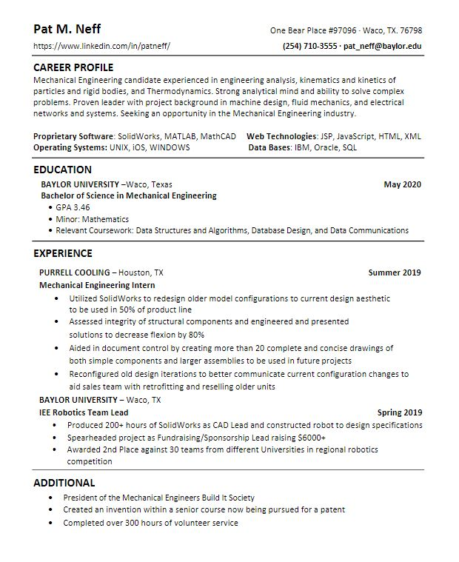
Handshake→ Career Center→ Resources→ choose your college→ resume template
You need an ATS compatible resume
ATS scan your resume, so if they cannot read it, your resume won’t make it to a person.
KEEP IT SIMPLE (use Career Center Template!)
Avoid:
Text boxes
Writing in headers/footers
Charts
Tables
PICTURES

Slide 8
What can I put on my resume?
Education: degree type (write out: Bachelor of Science, Bachelor of Arts, etc.
Major, minors.
College and beyond (leave off high school)
Work experience
Internships (paid or unpaid)
Research experience
Volunteer experience
Leadership experience, such as leadership positions in clubs
Certifications
Relevant projects
Other relevant experiences & positions

Slide 9
Tailoring your resume
Your resume will change depending on what you are applying to.
You will tailor your resume based on terms in the job description.
Resource: https://www.jobscan.co/

Slide 10
CAREER PROFILE​
​
Brief, 3-4 sentences fragments showing how you are a strong fit for the position​
Highlight your most desirable attributes related to the job/goal – Do you have experience with larger-scale surveys? Have you written grants?​
Showcase your personal brand​
What are you known for - Flexibility? Communication?​ This is the place on the resume where you can include soft skills!
Remember to support your qualifications in your Experience section below

Slide 11
EDUCATION
List highest degree first
Include relevant concentrations, honors, awards if applicable

Slide 12
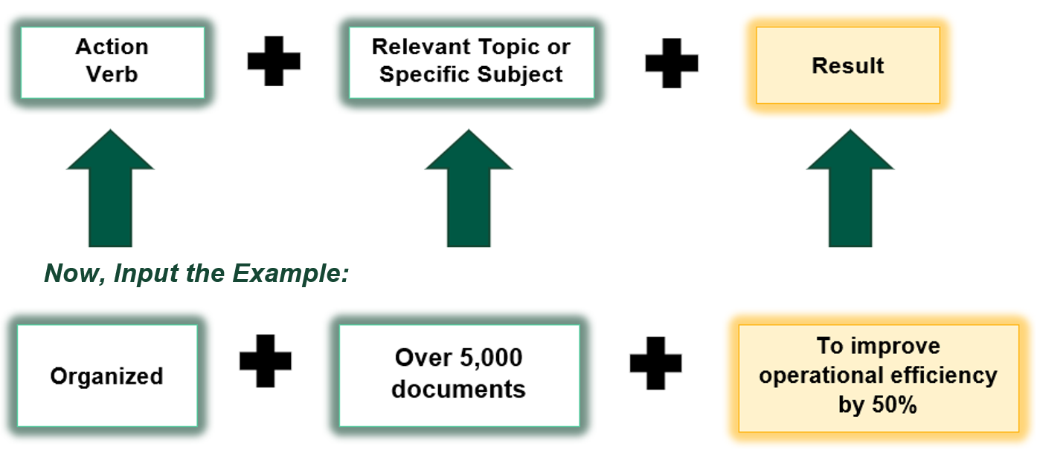
CREATING STRONG BULLET POINTS

Slide 13
WORDS and PHRASES TO AVOID
Assisted/helped/aided
Worked with
Responsible for
Supported
Tasked with:
Used (lab skills/SPSS/field techniques)

Slide 14
ADDITIONAL
Includes anything that didn't fit in your experience section
Languages
Certifications/Licenses
Memberships in clubs/professional orgs
Community involvement/volunteering

Slide 15
DO'S
DON'TS
Edit for grammar and spelling!
Tailor Career Profile and Experience to the job/internship
Include deliverables and quantities
Undersell yourself
Use weak action verbs
Be dishonest for the sake of tailoring your resume to the job

Slide 16
Career Exploration/ Job Search Resources
- Informational Interviews
- LinkedIn
- Careershift
- Handshake

Slide 17
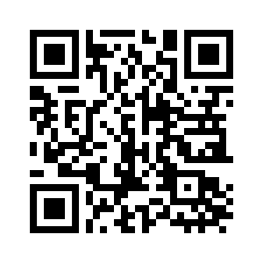
Questions?
Sydnee_Humphries@baylor.edu
Schedule an appointment in Handshake

